Slide 1
Global
Shark Attacks
A glance at fatal statistics
from 1950 to 2024

Slide 2
About what we are going to see
01
Presentation
02
Technical methods
03
Results
What we will see and why
Development of database processing
Statistics resulting from data analysis

Slide 3
01
Presentation

Slide 4
A new reading on
Global Shark Attack File
In this new analysis of the well-known Global Shark Attack File (GSAF) we will address the information to understand the reality about the lethality of shark attacks and clearly visualize the human factors that provoke them.
The database, although it contains records of attacks since 1500, has been filtered in a range from 1950 to the present days so that the analysis better reflects current events.

Slide 5
02
Technical
methods

Slide 6
Methodology used to obtain statistics
Grouping of information and operations on it to obtain values to be interpreted
Grouping and filtering
Interpretation
Cleaning and formatting
Data evaluation and reading
Elimination of data and standardization of values in the DB

Slide 7
03
Results

Slide 8
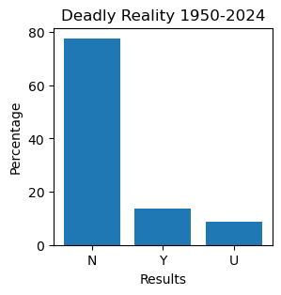
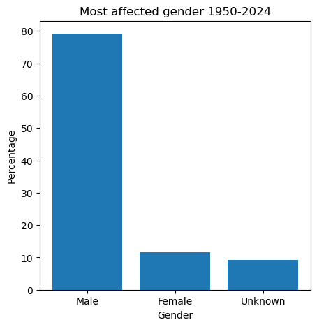
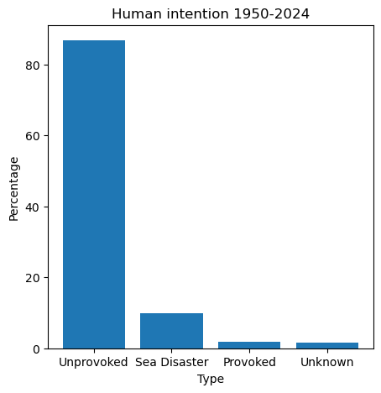
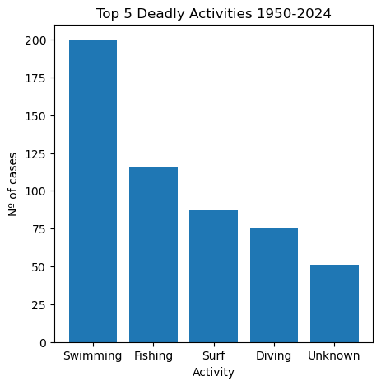
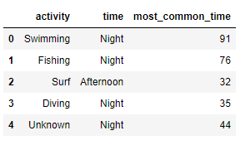
Plots to understand
Deadly report
Gender relation
Human interaction
Activity relation
Deadliest activity per time

Slide 9
Thank You!

